Slide 1
Software Development 2
Java Interfaces and Multiple Inheritance
F27SB

Slide 2


Socrative room: F27SB
A LITTLE QUIZ

Slide 3
Question 1
Java constants by convention use the following modifiers.
final
public
private
void
static

Slide 4




Question 2
List<String> list =
new ArrayList<>(); list.add("One");
list.add("Two");
list.add("Three");
Which of the following pieces of code correctly prints the content of this list?
Iterator<String> it = list.iterator(); while(it.hasNext()) {
System.out.println(it.next());
}
Iterator<String> it = list.iterator(); while(String s = it.next()) {
System.out.println(s);
}
for(Iterator<String> it = list.iterator(); it.hasNext(); ) { System.out.println(it.next());
}
Iterator<String> it = list.iterator(); for(String s : it) {
System.out.println(s);
}

Slide 5
Question 3
Which statements about abstract classes are true?
Abstract classes can only have abstract methods
A subclass can inherit from multiple abstract classes
Abstract classes cannot be instantiated
A subclass must implement all abstract methods (otherwise it will be abstract itself)
Abstract classes cannot have private fields (member variables)
Abstract classes may contain abstract methods and also implemented methods (i.e. with a body)

Slide 6
So far: Abstract Classes
Abstract Classes are super classes for inheritance.
Can contain abstract methods and concrete/ implemented methods.
Subclasses inherit code from super classes must override (implement) abstract methods.
Dynamic method lookup.
Abstract keyword.

Slide 7
Why Abstract Classes
Implement diverging behaviour in subclasses.
Abstract classes cannot be instantiated
Guarantee that no instance of this object will “live in your Java world”.

Slide 8


EXAMPLE LAB SOLUTION

Slide 9

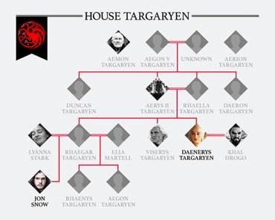
Here be spoilers
Interfaces and multiple inheritance
TODAY’S LESSON

Slide 10
Lesson Outline
Method overloading
Java Interfaces
Extending the FoxesAndRabbits code with Multiple Inheritance
Interfaces vs. Abstract Classes

Slide 11
Method overloading
How to allow a method/constructor to accept different arguments
Define the same method/constructor multiple times
Use different arguments in definition
Java compiler will use the method that applies based on the arguments given when called

Slide 12



Method overloading
public class Dog extends Mammal { public void bark() {
System.out.println("Woof!");
}
public void bark(int n) { for(int i = 0; i < n; i++) {
System.out.println(“Woof!”);
}
}
public void bark(int n, String text) { for(int i = 0; i < n; i++) {
System.out.println(“Woof!”);
}
}
Code duplication
}

Slide 13

Method overloading
public class Dog extends Mammal { public void bark() {
bark(1);
}
public void bark(int n) { bark(n, “Woof!”);
}
public void bark(int n, String text) { for(int i = 0; i < n; i++) {
System.out.println(text);
}
}
}

Slide 14
Back to hunting - Abstract classes v Interfaces
FOXES AND RABBITS

Slide 15

The Animal class
public abstract class Animal
{
//fields omitted
/**
Make this animal act - that is: make it do
whatever it wants/needs to do.
*/
abstract public void act(List<Animal> newAnimals);
//other methods omitted
}

Slide 16
Limitation
In Java, a class can only inherit from a single superclass!
– Abstract or concrete.

Slide 17
Multiple Inheritance
EXTENDING THE FOXES-AND- RABBITS CODE

Slide 18
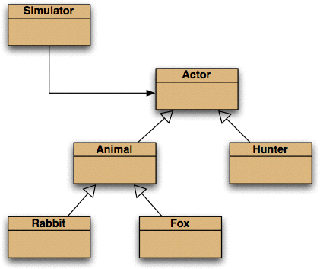
Further abstraction

Slide 19
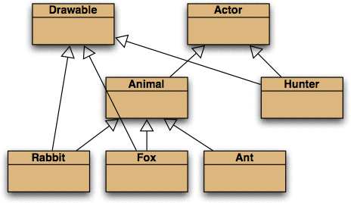
Selective drawing: Multiple Inheritance

Slide 20
Multiple inheritance
Having a class inherit directly from multiple ancestors.
Each language has its own rules.
How to resolve competing definitions?
Java forbids it for classes.
Java permits it for interfaces.
No competing implementation.

Slide 21


An Actor interface
public interface Actor
{
/**
Perform the actor's regular behaviour.
@param newActors A list for storing newly created
actors.
*/
All methods abstract and public. No keywords needed!
void act(List<Actor> newActors);
/**
Is the actor still active?
@return true if still active, false if not.
*/
boolean isActive();
}

Slide 22
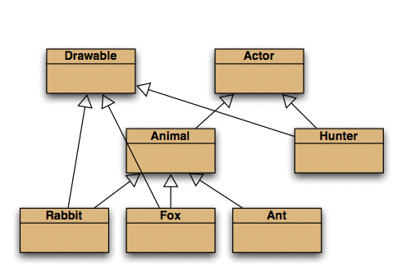


Classes implement an interface
public class Fox extends Animal implements Drawable
{
...
}
public class Hunter implements Actor, Drawable
{
...
}

Slide 23
Features of interfaces
All methods are abstract.
There are no constructors.
All methods are public.
All fields are public, static and final.

Slide 24
Interfaces as types
Implementing classes do not inherit code, but ...
... implementing classes are subtypes of the interface type.
So, polymorphism (method overriding) is available with interfaces as well as classes.

Slide 25
Interfaces as specifications (APIs)
Strong separation of functionality from implementation (loose coupling).
Though parameter and return types are mandated.
Clients interact independently of the implementation.
But clients can choose from alternative implementations.

Slide 26
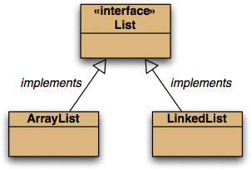

Alternative implementations
private List<Type> newList = new LinkedList<Type>(); private List<Actors> newActors = new ArrayList<Actor>();

Slide 27

Another example: Predator Interface
public interface Predator
{
boolean huntPrey(Prey p); void eatPrey(Prey p);
}

Slide 28

Subtypes of Predator
public class Lion implements Predator {
public boolean huntPrey(Prey p) {
//programming to chase prey p
//(specifically for a lion)
}
public void eatPrey(Prey p) {
//programming to eat prey p
//(specifically for a lion)
}
}

Slide 29

Multiple Interfaces
public class Frog implements Predator, Prey { ... }

Slide 30

Decoupled Use
List<Predator> predators = new ArrayList<Predator>();
for(Iterator<Predator> it = predators.iterator();it.hasNext();)
{
Predator predator= it.next(); predator.huntPrey(prey);
if(chatchPrey(prey)==true)
{
eatPrey(prey);
}
}

Slide 31





Which type of object are you?
public void setColors(List<Actor> actors)
{
for(Actor actor : actors){
if (actor !=null & actor instanceof Drawable)
{
Color color=(Color)((Drawable) actor).getColor(); view.setColor(actor.getClass(), color);
}
}
}

Slide 32

instanceof Keyword
The instanceof keyword can be used to test if an object is of a specified type or subtype.
is-a relations
if (objectReference instanceof type)

Slide 33
THE CLASS OBJECT

Slide 34

The Class class
A Class object is returned by getClass()
in Object.
The .class suffix provides a Class object: Fox.class
Used in SimulatorView:
view.setColor(Fox.class, Color.BLUE);
String getName() for the class name.

Slide 35
instanceof vs. getClass()
instanceof tests whether the thing on the LHS is an instance of the type on the RHS or some subtype.
actor instanceof Drawable
object.getClass() == ... tests whether the types are identical.
Notes:
If you need anything to be of the same type use object.getClass()
If you need anything to be of same type or a substype – instance of

Slide 36
Summary: Java Interfaces
A Java Interface is an abstract type that is used to specify an interface (= set of features) that classes must implement.
Similar function to Abstract Classes, but without any implementation (fully abstract).
Provides shared type information, no code inheritance.
Tool for (multiple) Inheritance, Abstraction, Information Hiding -> reduce coupling

Slide 37
Interfaces vs. Abstract Classes
Feature | Interface | Abstract Class
Multiple Inheritance | A class may implement several interfaces. | A class may extend only one abstract class.
Default implementation | An interface can’t provide any code at all. | An abstract class can provide implemented methods.
Constants | Static final constants (= class fields) only. | Both instance and static constants are possible.
Third party convenience | An interface implementation may be added to any existing third part class. | A third party class must be rewritten to extend only from the abstract class.

Slide 38
When to choose which one?
How similar is their behaviour? Any shared implemented methods?
code inheritance from abstract classes
How modular does the code need to be? How much information hiding is required?
Interfaces allow better information hiding
Need multiple inheritance?
interfaces allow a more flexible and extendible code structure.

Slide 39
Summary
Java Interfaces are fully abstract types.
Interfaces allow multiple inheritance.
Abstract Classes and Interfaces are both appropriate in different circumstances.
Both improve your code by loose coupling.

Slide 40
THAT’S IT!

Slide 41
Homework
Finish reading Chapter 10 “Further abstraction techniques”.

